Slide 1
Exploring Intertextual Networks in Women’s Writing: A digital tool and its story
Julia Flanders, Northeastern University
@julia_flanders

Slide 2
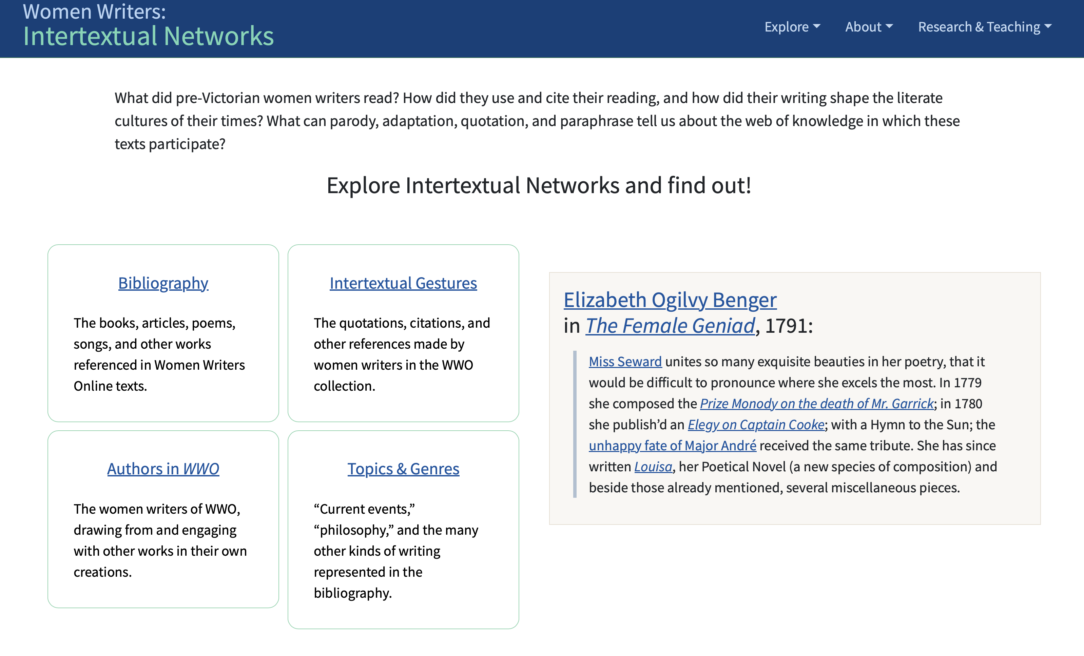

Slide 3
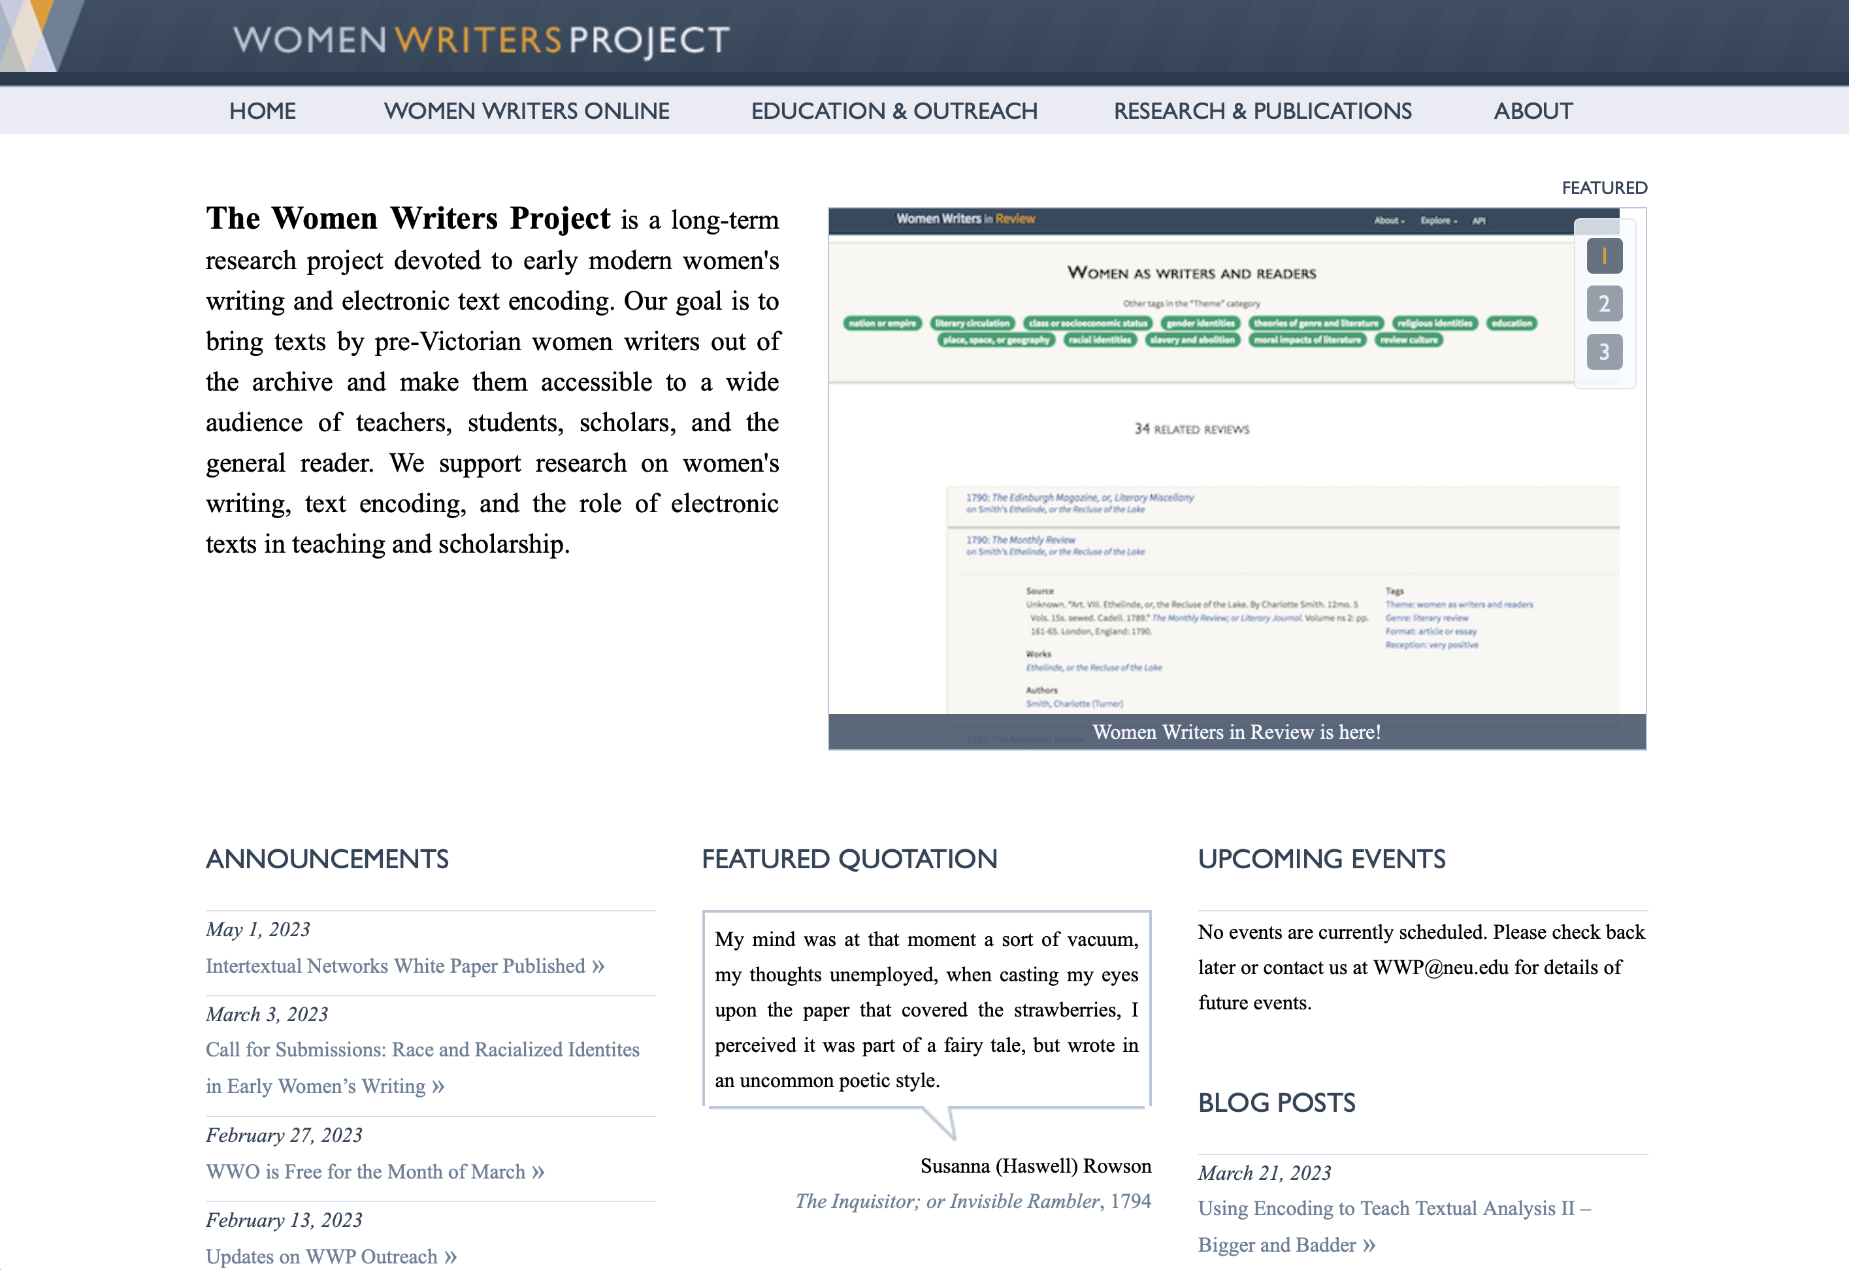

Slide 4
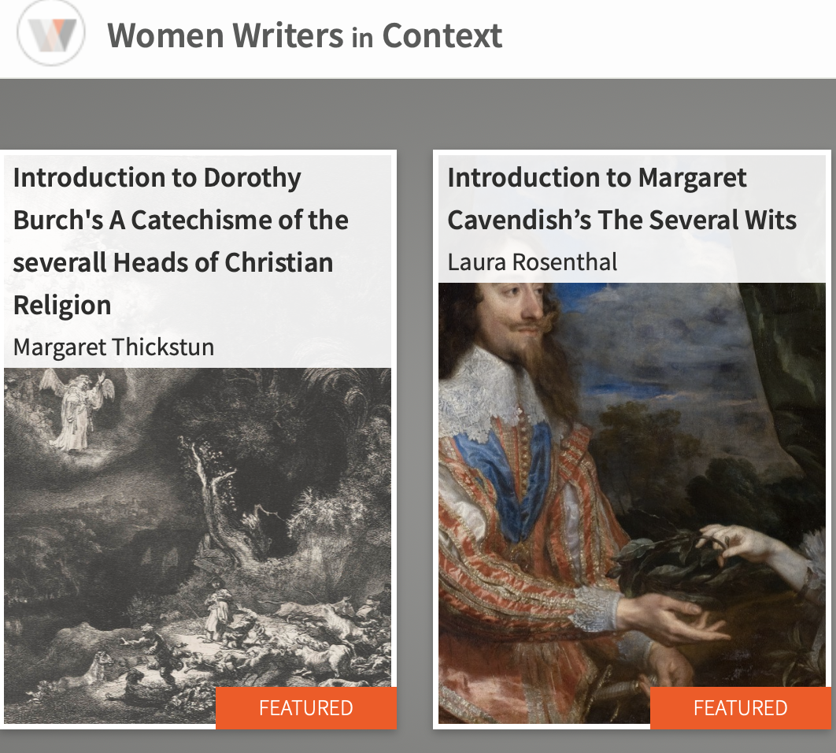

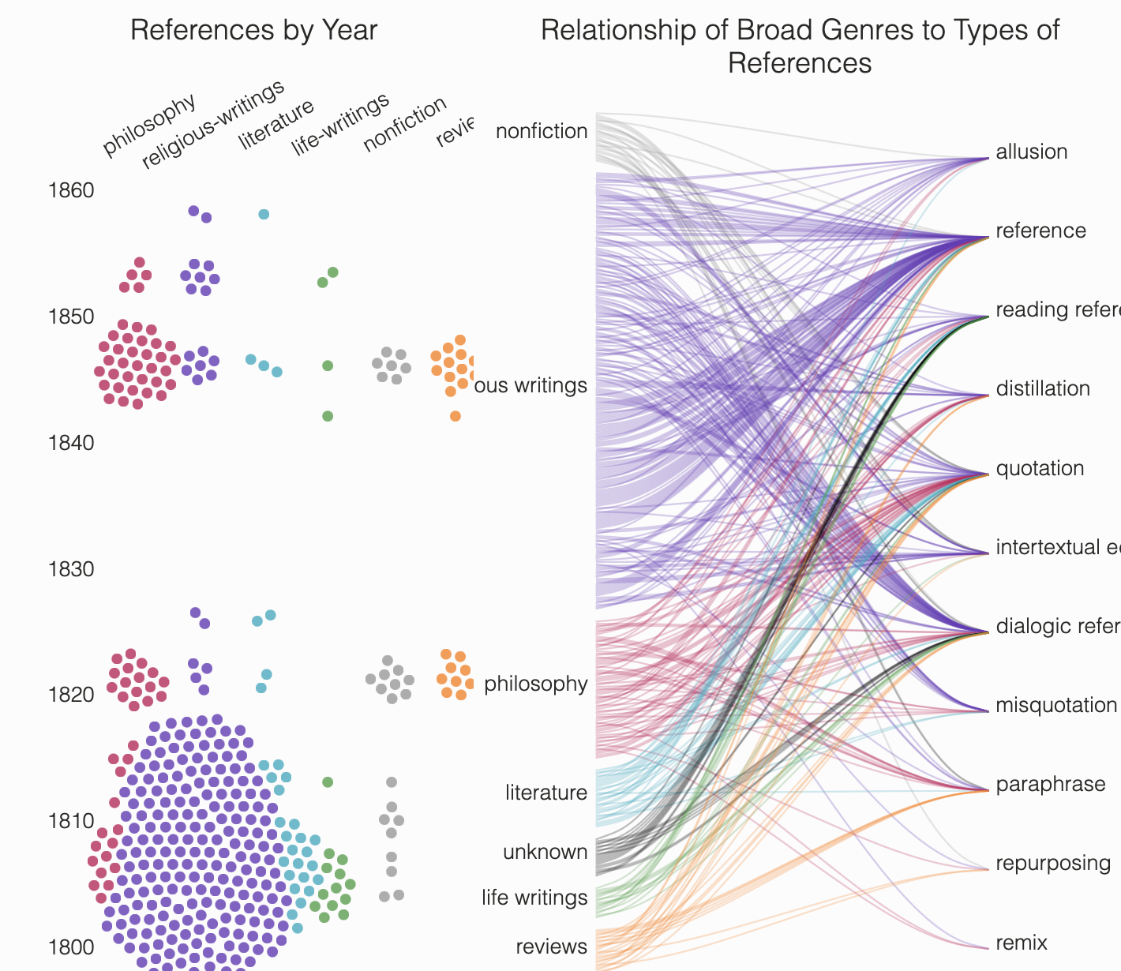

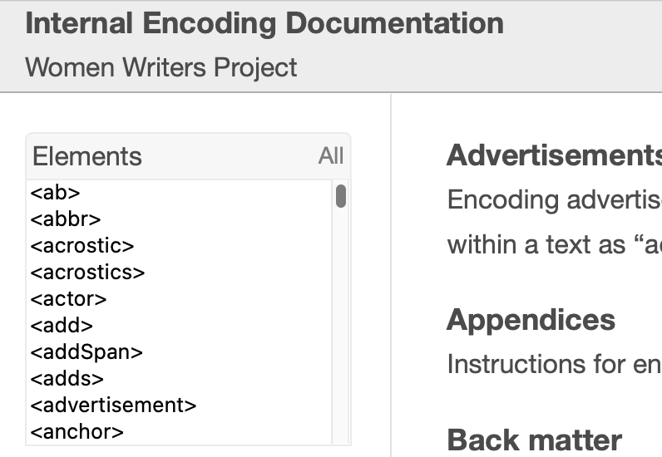



Slide 5
Currently about 450 texts, roughly 1530-1850
Text by women, translated by women, co-authored by women, texts reporting women’s words, texts which circulated as being by a female author
Printed texts, with experimental exceptions

Slide 6
<text> <pb n="001"/> <milestone unit="sig" n="B1r"/> <body> <div xml:id="p01" type="poem"> <head rend="case(allcaps)post(#rule)">Epistles <lb/>on the <lb/>Character and Condition of Women, <lb/>in <lb/>Various Ages and Nations.</head> <head rend="case(allcaps)" type="sub">Epistle I.</head> <argument> <head rend="post(#rule)case(allcaps)">Argument of Epistle I.</head> <p rend="first-indent(-1)indent(0)">Subject proposed—the fame of man extended over every period of life—that <lb/>of woman transient as the beauty on which it is founded—Man renders <lb/>her a trifler, then despises her, and makes war upon the sex with <persName>Juvenal</persName>…</p></argument> <lb/>and <persName ref="p:apope.xmo">Pope</persName>. A more impartial view of the subject to be attempted. <lb/>Weakness of woman, and her consequent subserviency. General view <lb/>of various states of society undertaken. Birth of <persName>Eve</persName>—Angels prophesy <lb/>the doom of the sex—description of <persName>Adam</persName> before he sees her—a joyless, <lb/>hopeless, indolent creature. Meeting of <persName>Adam</persName> and <persName>Eve</persName>—Change pro­- <lb/>duced in both—their mutual happiness and primary equality. Reflec-­ <lb/>tions. Conclusion.</p> </argument>
</div>
</body>
</text>

Slide 7
Quote
(admire? despise?)
Cite
(agree? disagree?)
Echo
(intentional? unintentional?)
Remix
(parody? expansion? appropriation?)
Levels of textual abstraction
I read…
“Shakespeare”
“A Midsummer Night’s Dream”
“Mr. Pope’s edition of 1725”

Slide 8
<div type="chapter"> <head>Evening Retrospection.</head> <epigraph> <quote> <lg type="poem" subtype="indeterminate"> <l>Did I this day for small or great,</l> <l>My own pursuits forego,</l> <l>To lighten by a feather's weight,</l> <l>The mass of human woe?</l> </lg> </quote> <bibl> <author> <persName>Jane Taylor</persName>
</author>.
</bibl> </epigraph> […]
</div>

Slide 9
The bibliography:
3,431 book-level work entries
942 chapter-level work entries
126 simple bibliographic entries (e.g. books of the bible).
The intertextual gestures:
11,787 quotations
5,692 titles
4,825 Biblical references
1,968 other bibliographic references
233 intertextual gestures in the files for our pilot commonplace book.

Slide 10
<biblStruct xml:id="TR00858" corresp="#frbr.work" ana="#poetry"> <monogr corresp="#frbr.expression"> <author> <persName gender="female" ref="p:aseward.lkq">Seward, Anna</persName> </author> <title type="display">Elegy on Captain Cook</title> <title type="wwo">Elegy on Captain Cook</title>
<title type="full">Elegy on Captain Cook. To which is added, an Ode to the sun. By Miss Seward</title> <imprint corresp="#frbr.manifestation"> <date when="1780">1780</date> <pubPlace> <placeName>London, England</placeName> </pubPlace> </imprint> </monogr> </biblStruct>

Slide 11
<title ref="b:IT00659" xml:id="t003">Midsummer-night's Dream</title>
<quote source="b:IT07317" xml:id="q061">They are all up—the innumerable stars!</quote>
<persName ref="p:egibbon.wjh">Gibbon</persName>

Slide 12
<div type="chapter"> <head>Evening Retrospection.</head> <epigraph> <quote source="b:IT07019"> <lg type="poem" subtype="indeterminate"> <l>Did I this day for small or great,</l> <l>My own pursuits forego,</l> <l>To lighten by a feather's weight,</l> <l>The mass of human woe?</l> </lg> </quote> <bibl source="b:IT07019" xml:id="b007"> <author> <persName ref="p:jtaylor.doq">Jane Taylor</persName>
</author>.
</bibl> </epigraph> […]
</div>

Slide 13
Full text transcription
…and I am piecing scraps from the <title ref="b:IT00659" xml:id="t003">Midsummer-night's Dream</title>, &c., to make a little scene… We have read <persName ref="p:egibbon.wjh" >Gibbon lately, who is certainly a very elegant and learned writer…
Bibliography
<biblStruct xml:id="IT00659">
Personography
<person xml:id="egibbon.wj">

Slide 14
allusion: An implied or indirect, but deliberate, reference to another text
dialogic_reference: Dialogue or direct address to authors or source material, or commentary on both in the form of debate, argument, or pondering/musing; or placement of authors in dialogue with each other
distillation: A synthesis of materials from a text or set of texts; may include direct quotation
intertextual_echo: A reproduction of ideas from another text or set of texts; a key distinction here is that the reproduction is not clear or specific enough to be identified as another form of intertextual gesture
paraphrase: A summary or representation of the meaning and content of material from another text that may or may not include some direct quotation of the original language
reading_reference: A mention of having read or otherwise engaged with another text
reference: A mention, typically brief, of material from another text
repurposing: A representation of material from another text that deliberately changes the meaning of the original

Slide 15
<itg type="dialogic_reference" source="b:IT55555 b:IT50072"> <itg type="reading_reference" source="b:IT55555">I have been these some days reading a little portion of scripture with attention</itg> — Can I ever forget the eternal consequence of love &amp; humility— <quote type="misquotation" source="b:IT50072"> rather may my right hand forget her use </quote>. I last night practiced anew on the latter—with success to the happiness of others I hope. </itg>

Slide 16
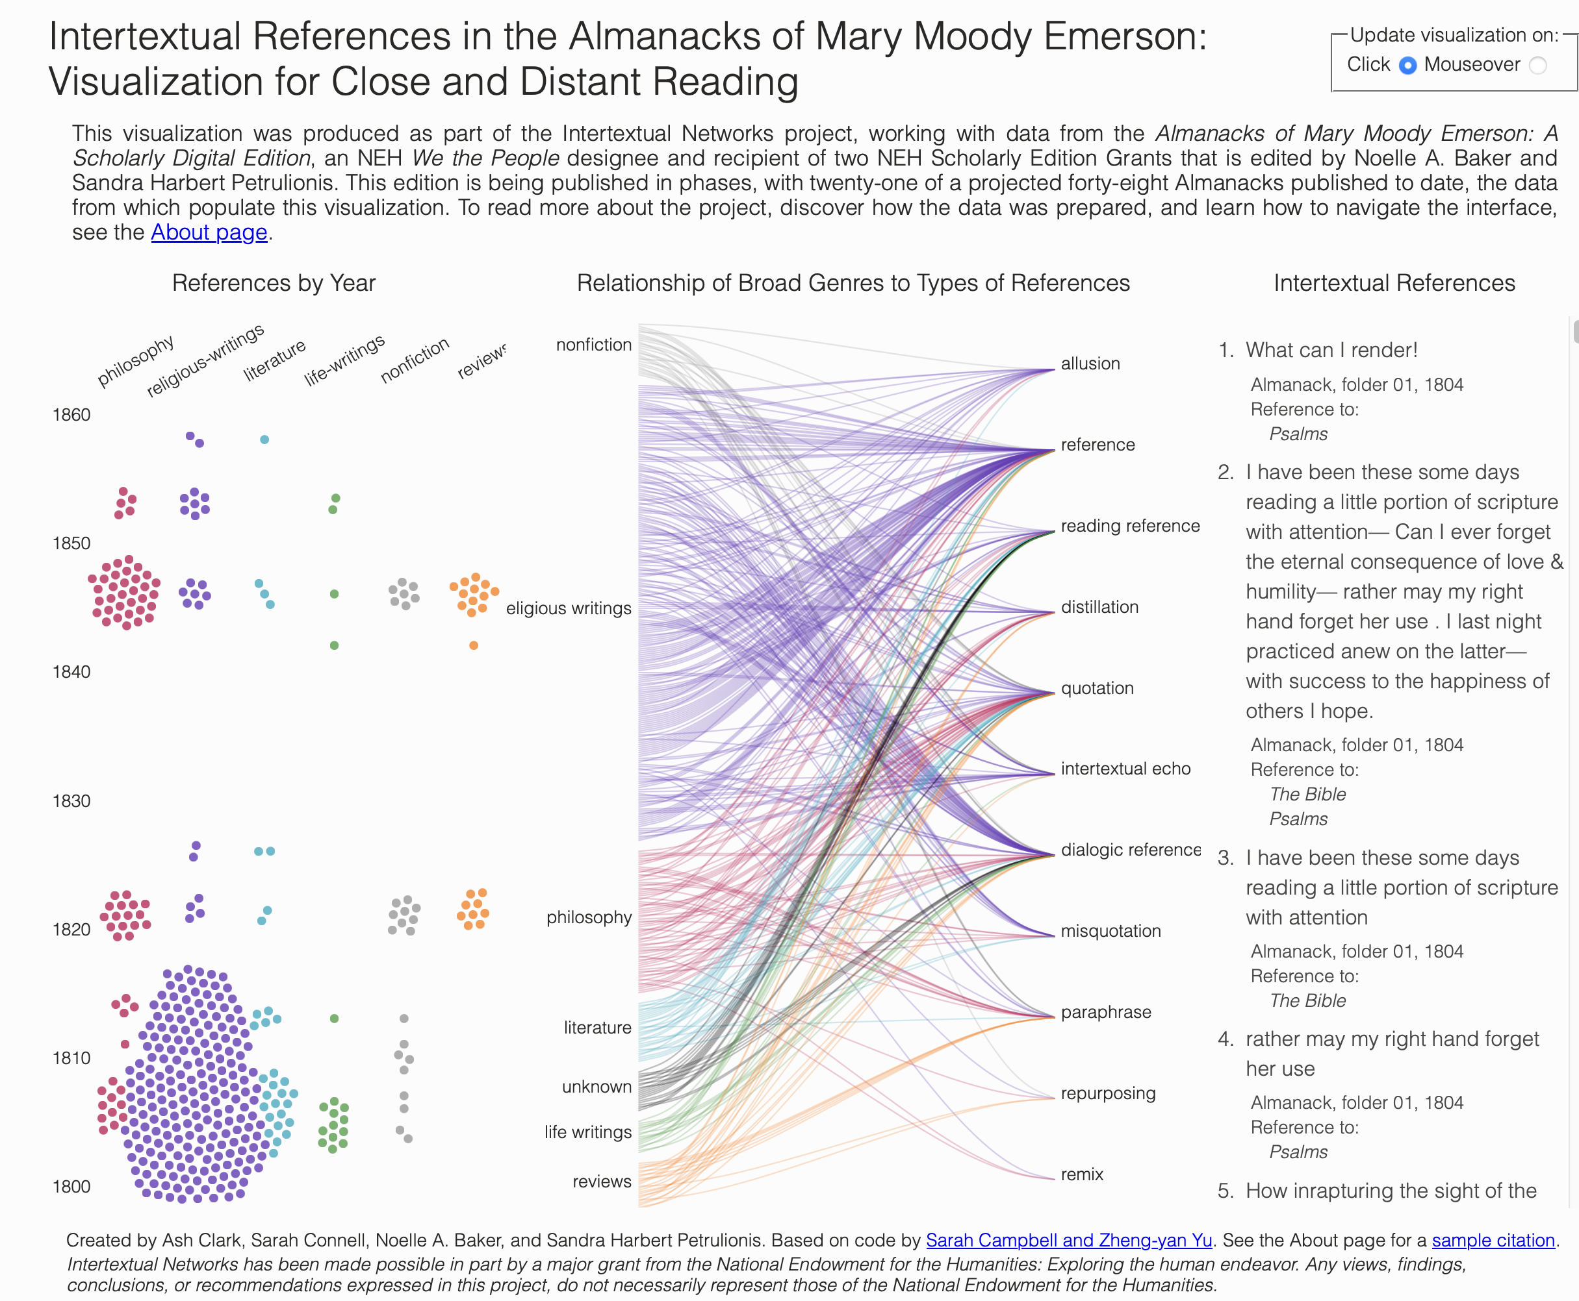

Slide 17
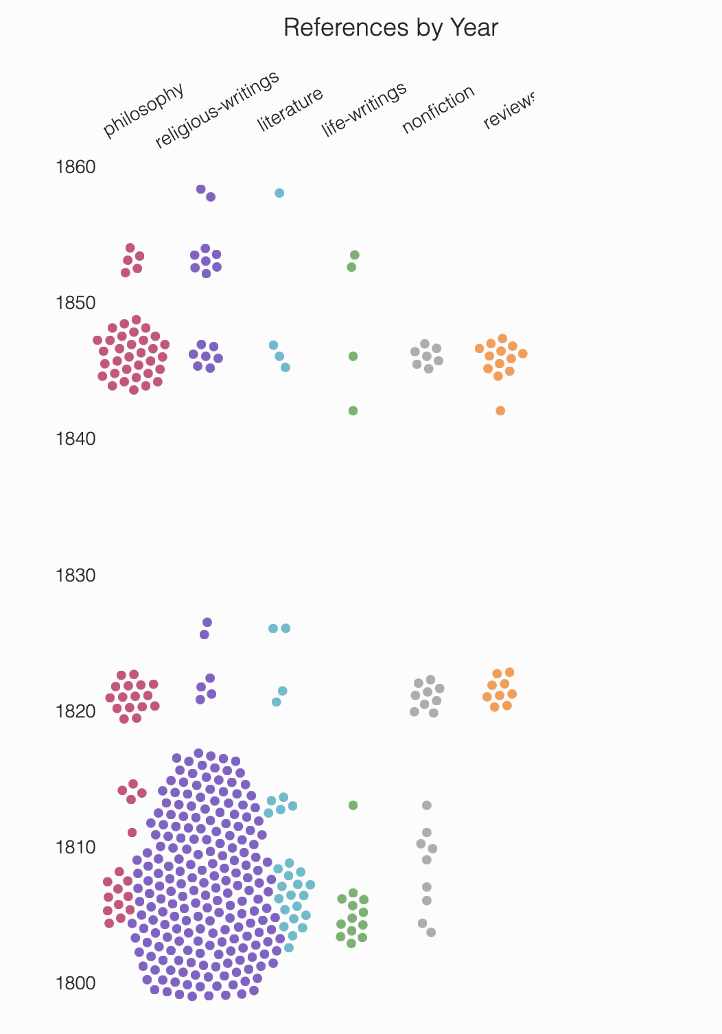
Intertextual references in Mary Moody Emerson’s Almanacks
By year
By genre

Slide 18
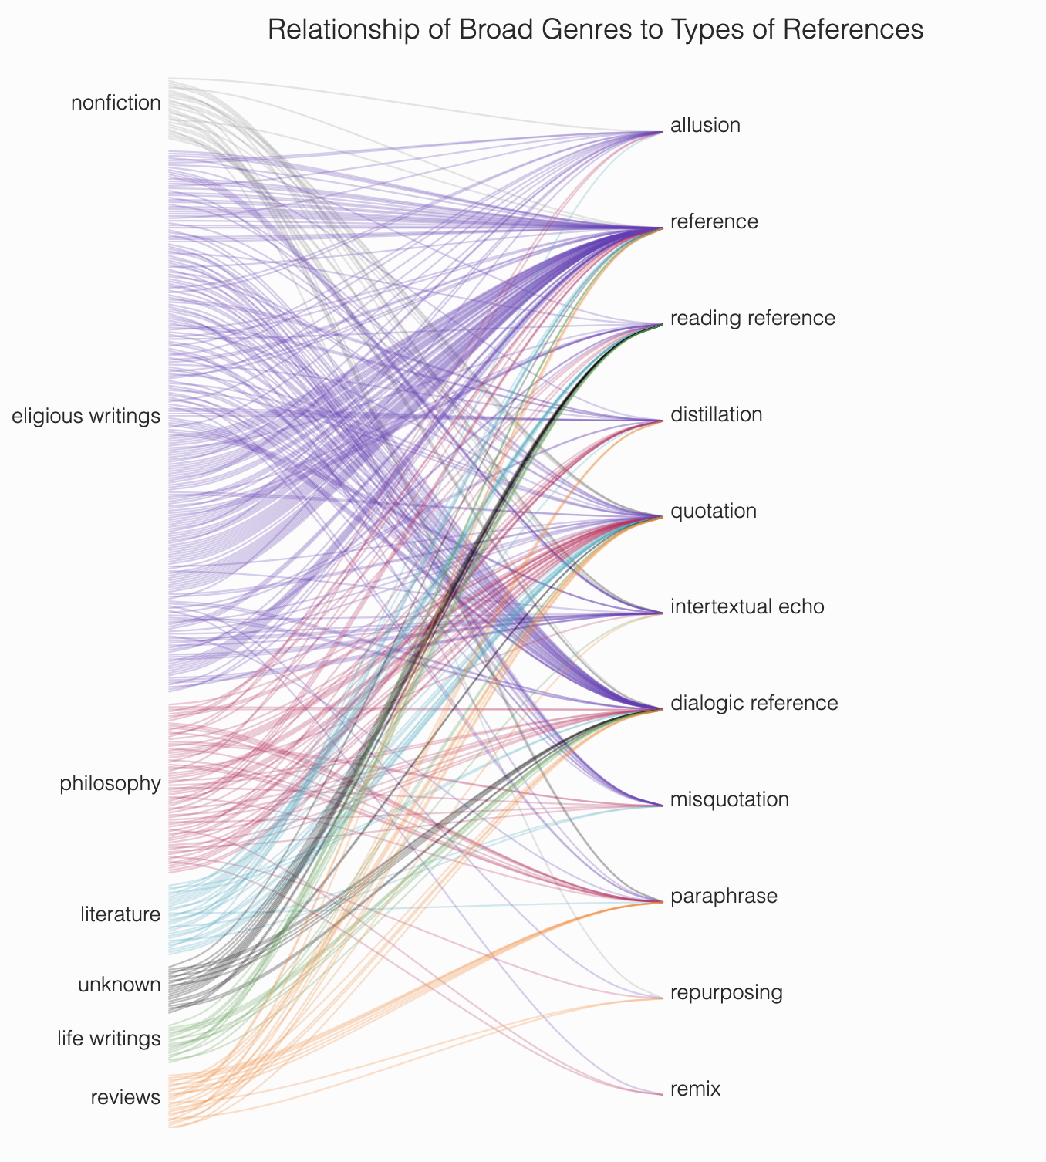
Intertextual references in Mary Moody Emerson’s Almanacks
Mapping the genre of the referenced text to the type of intertextual gesture
r

Slide 19
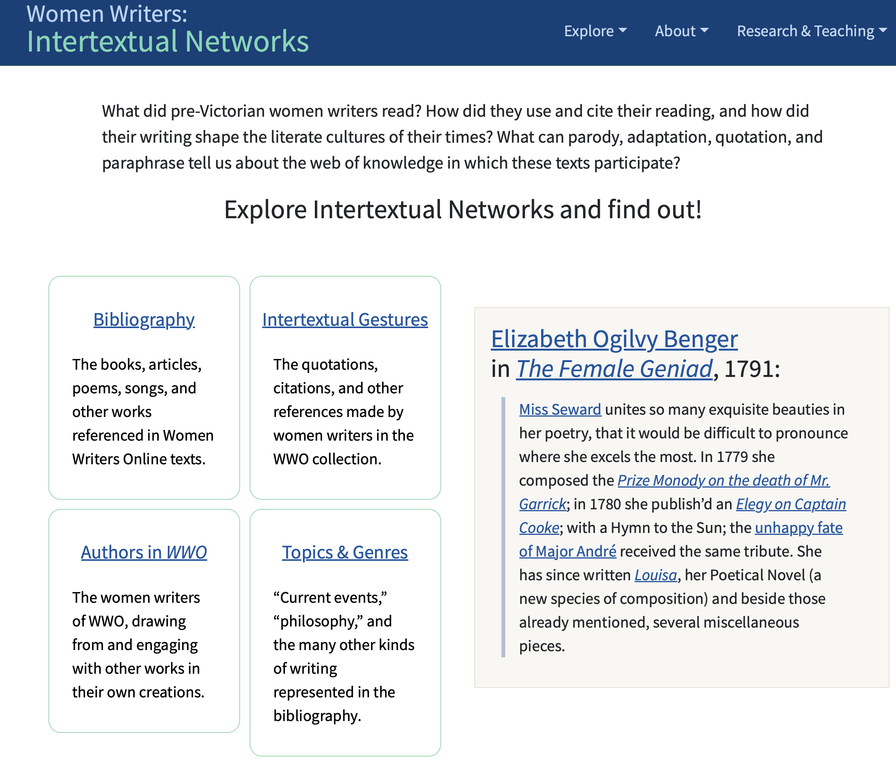

Slide 20
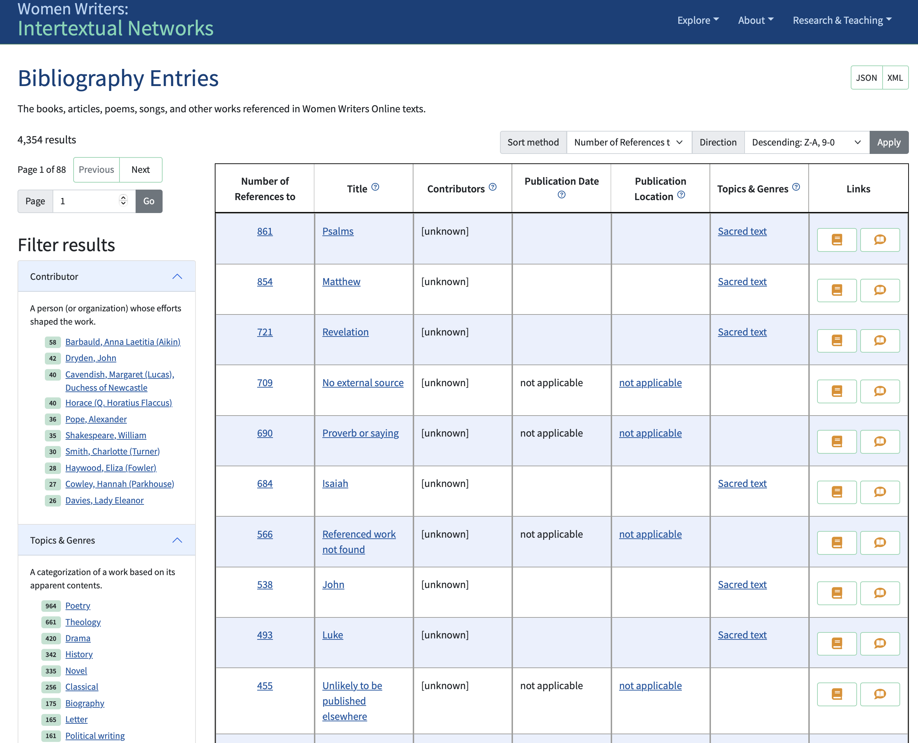

Slide 21
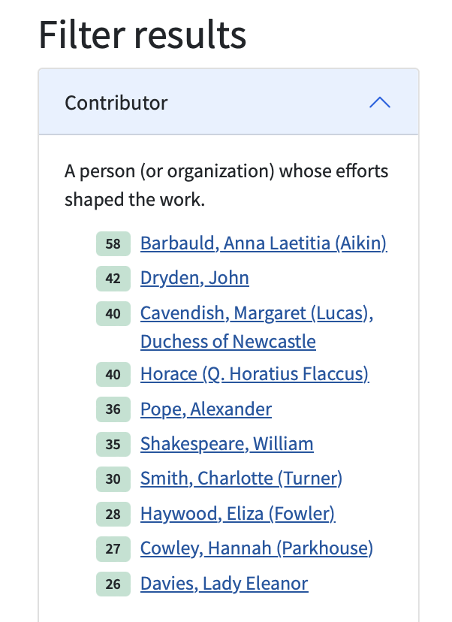
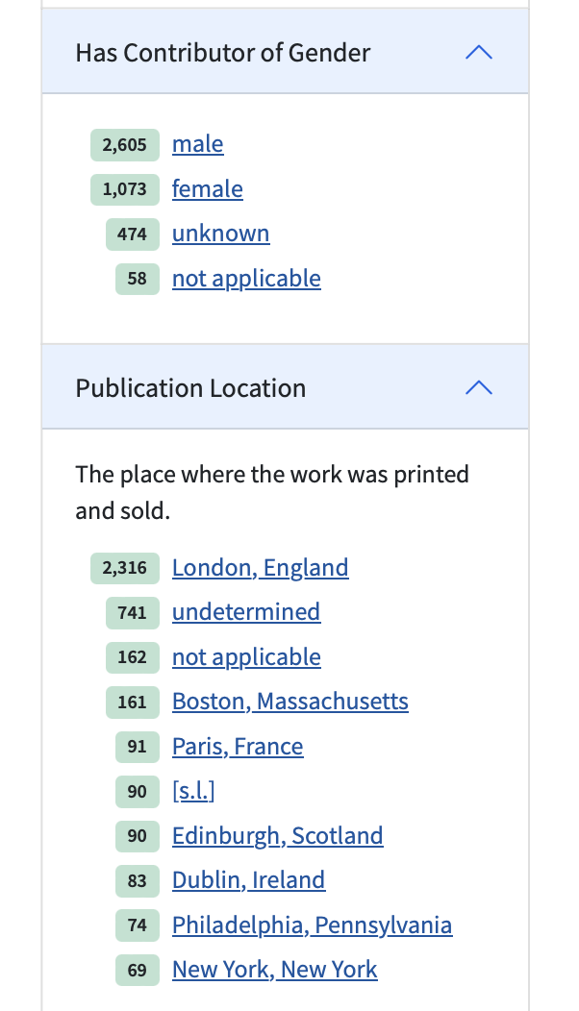
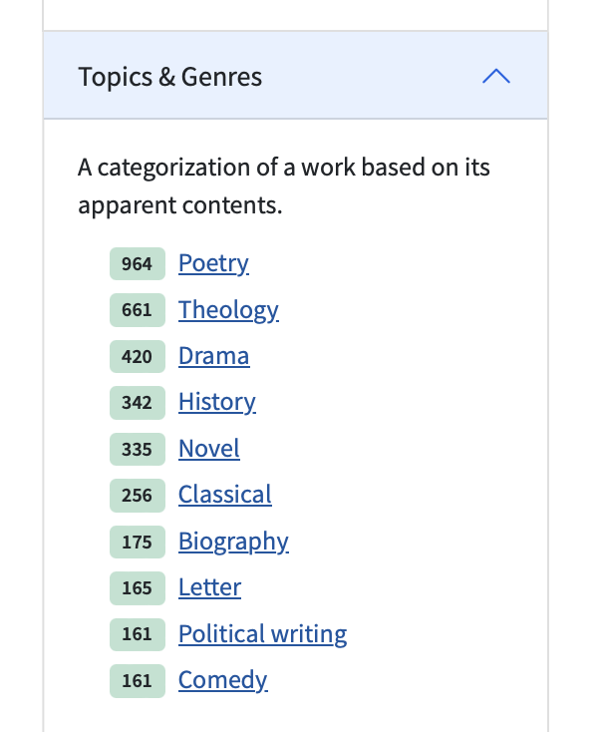

Slide 22
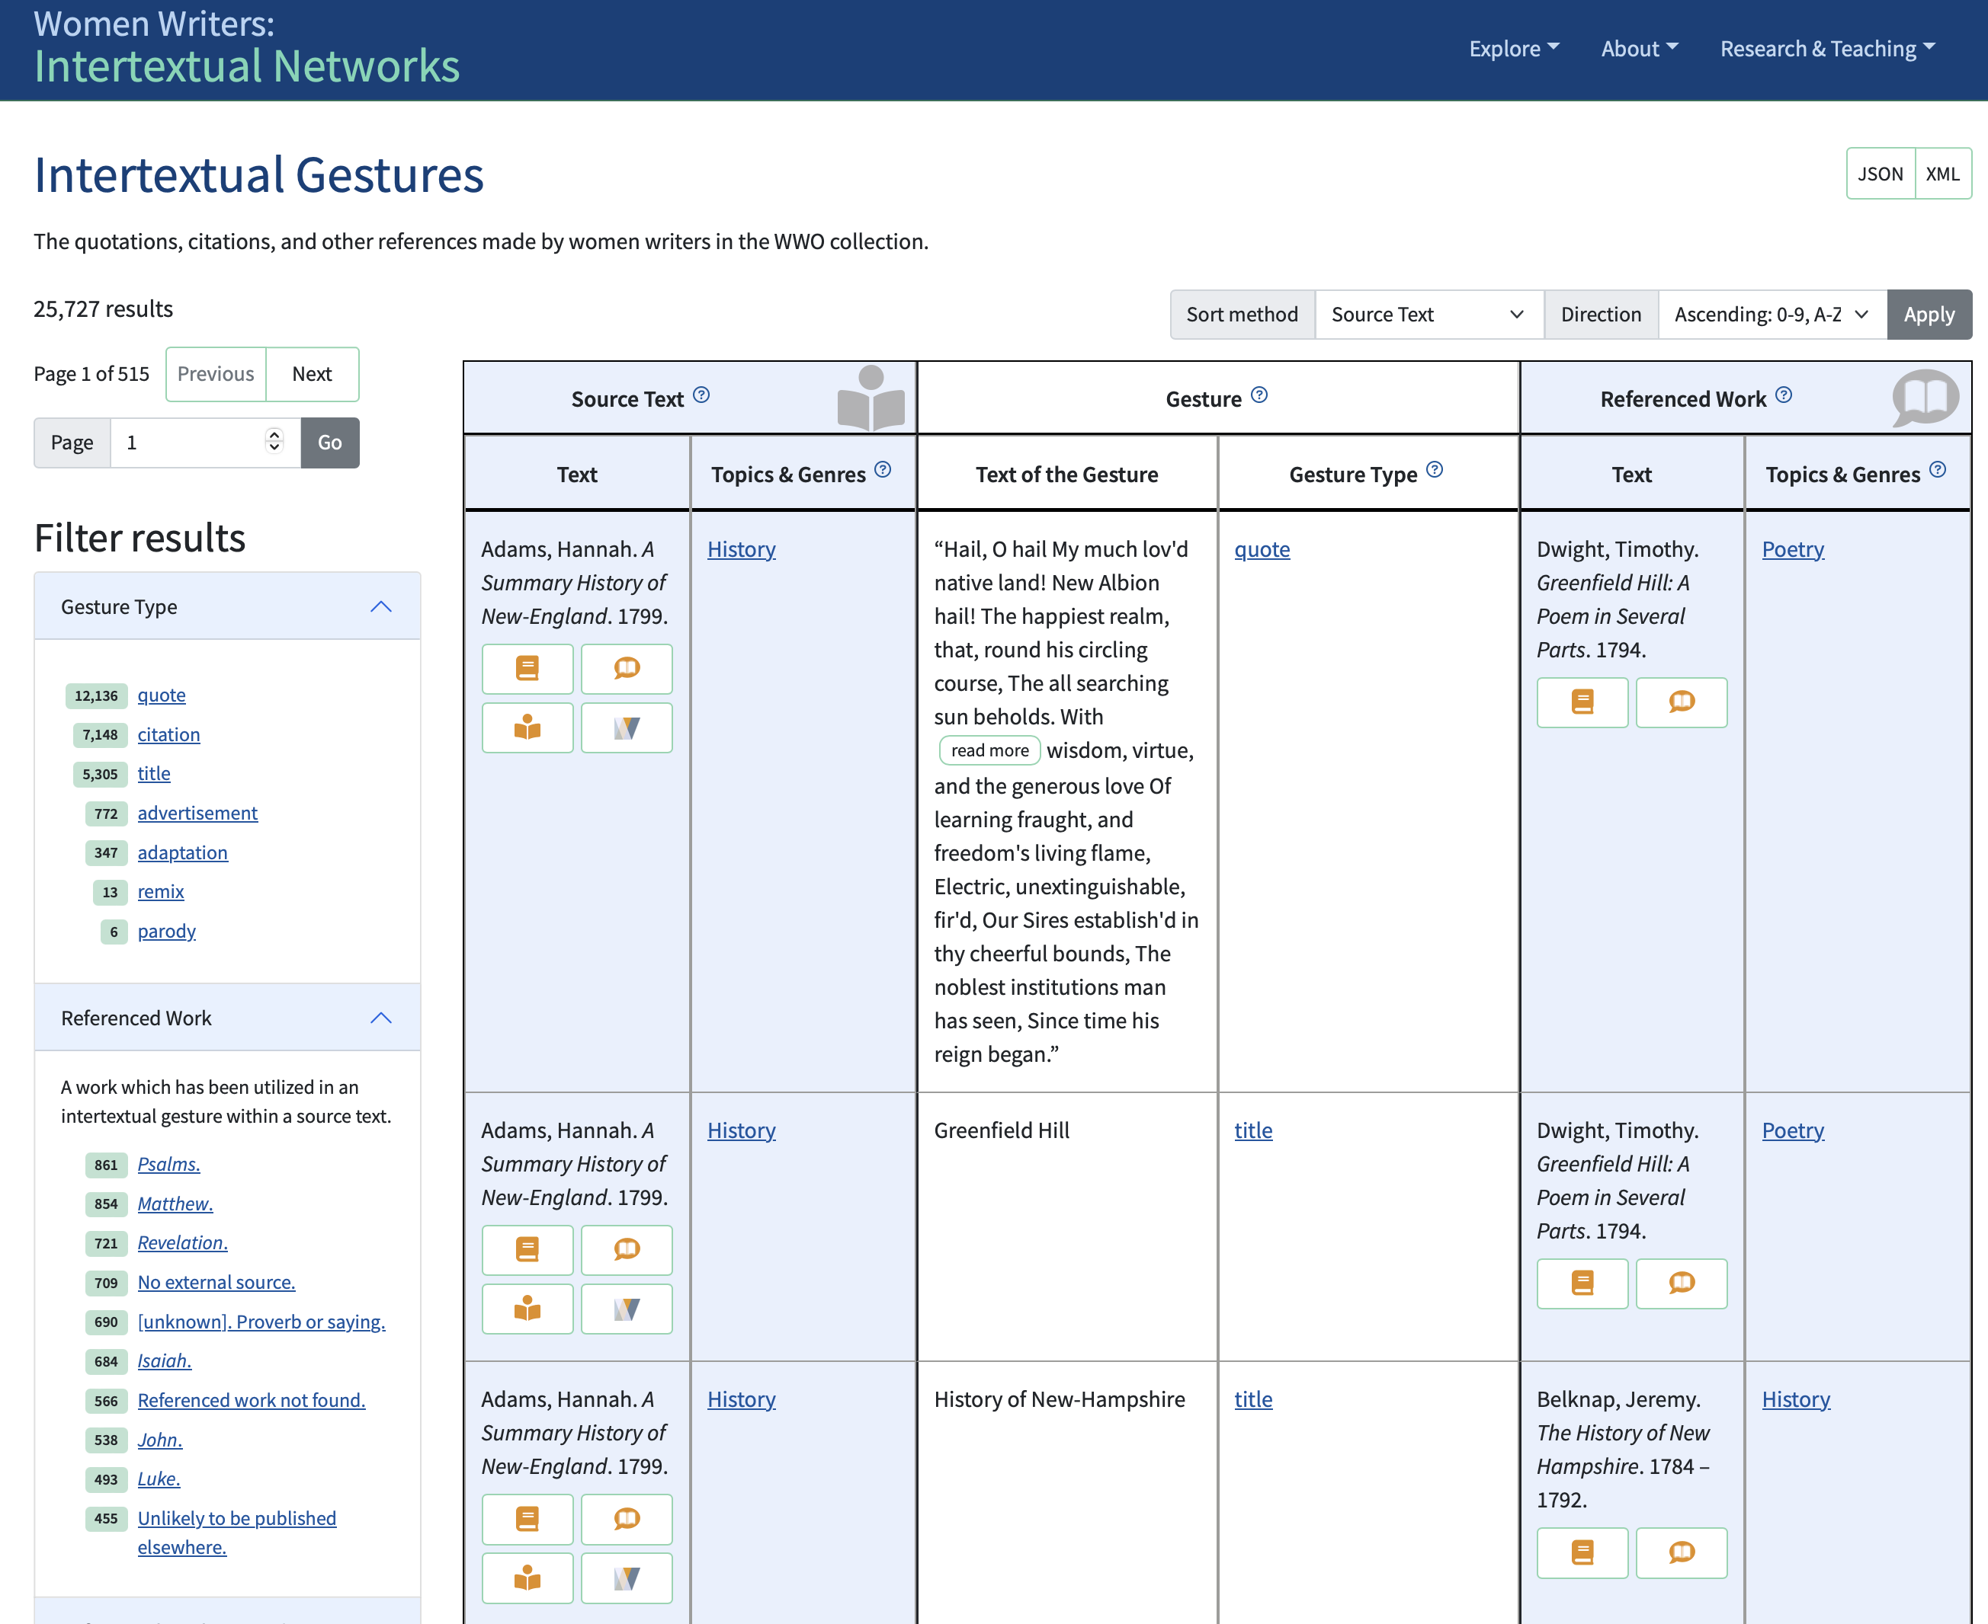

Slide 23
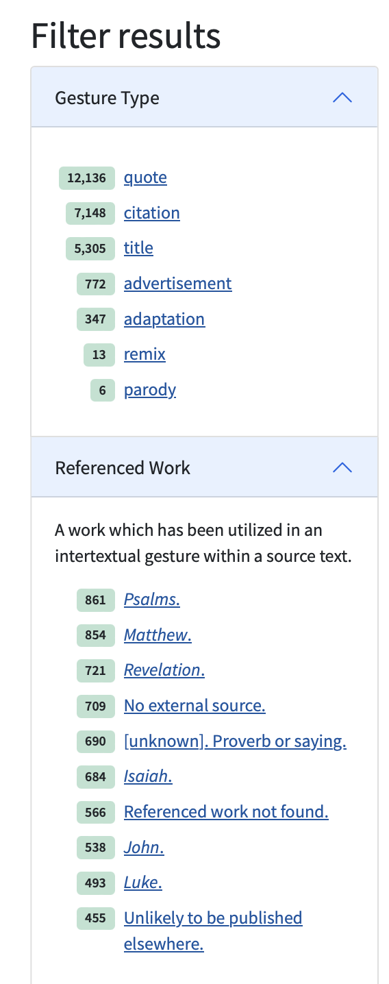
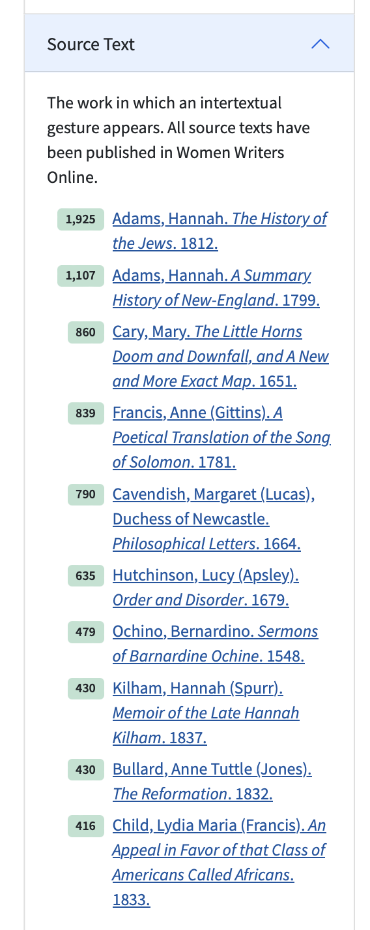
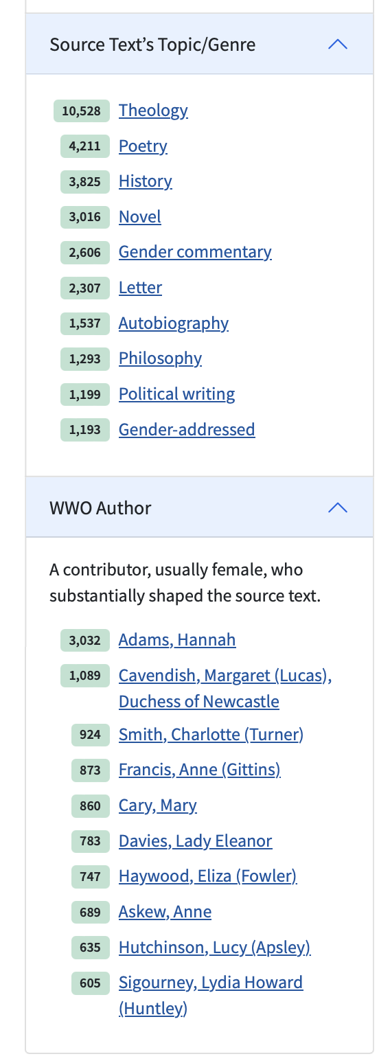
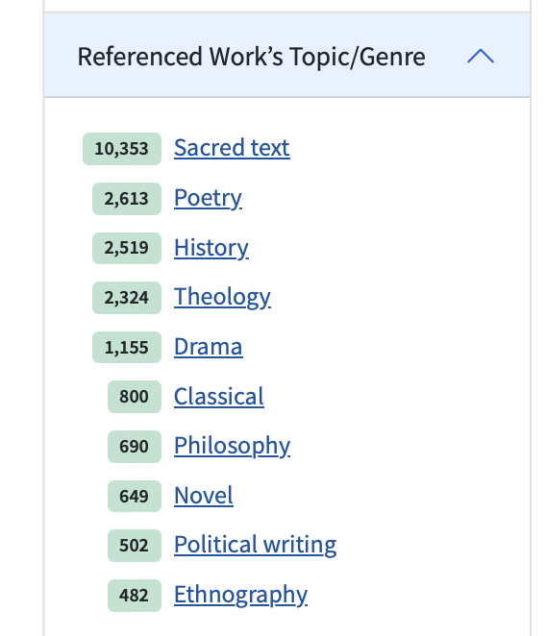

Slide 24
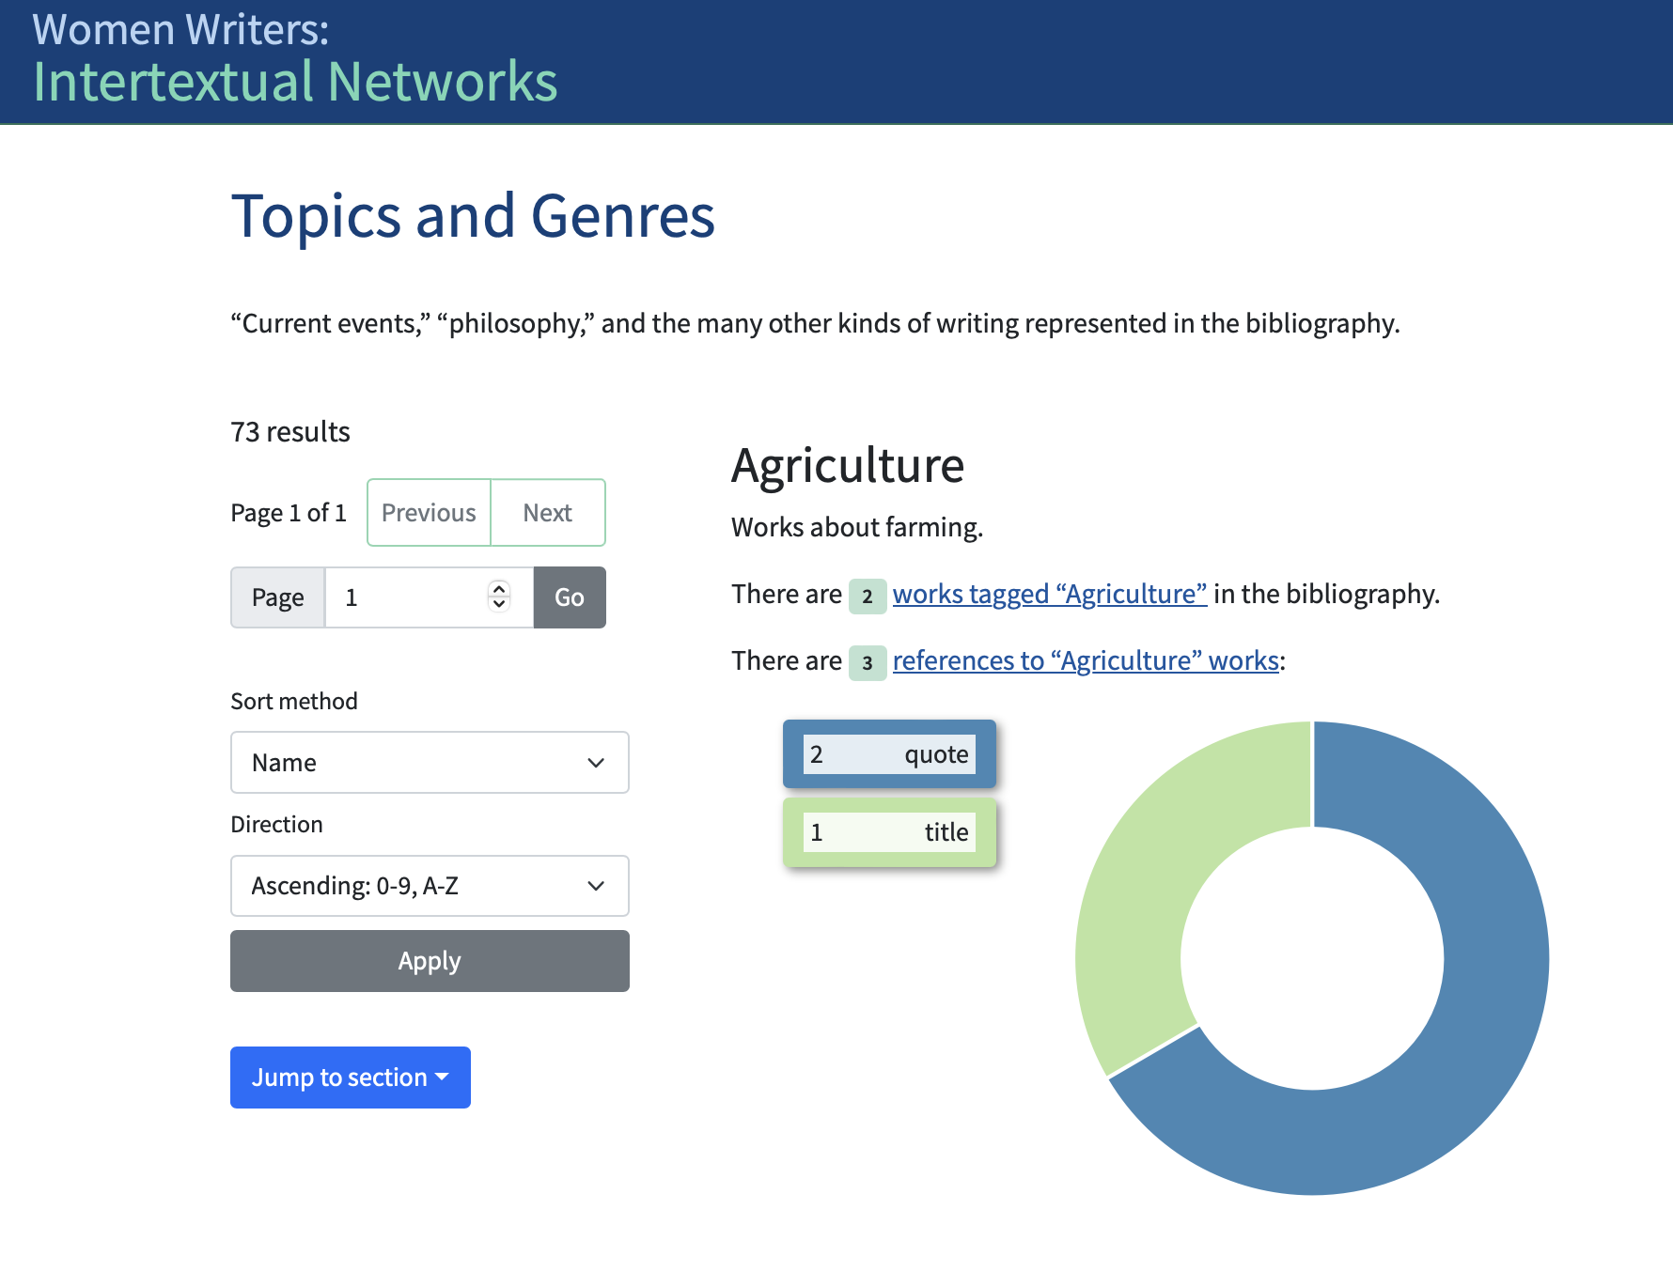
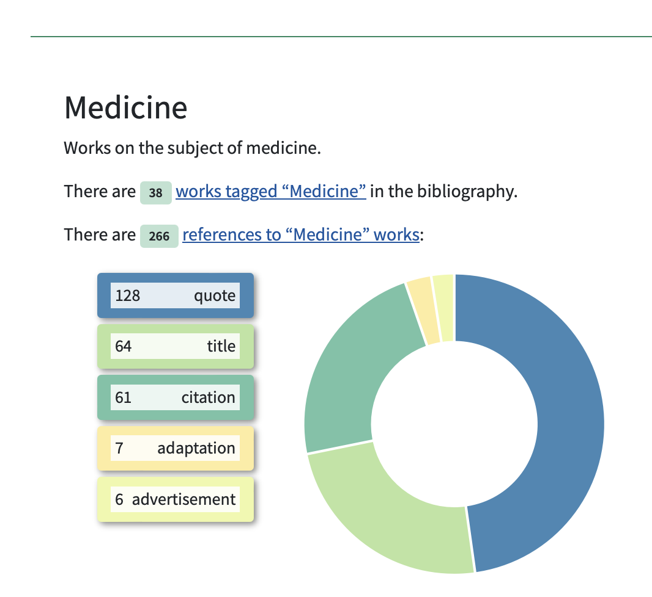
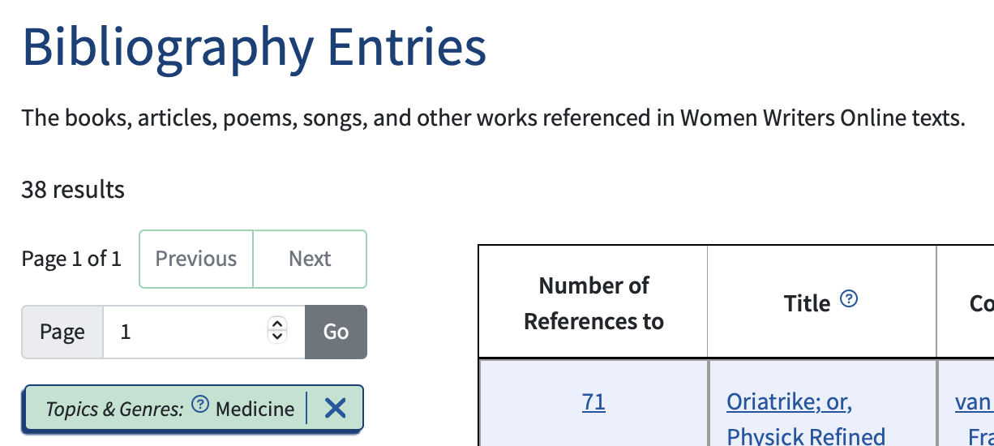
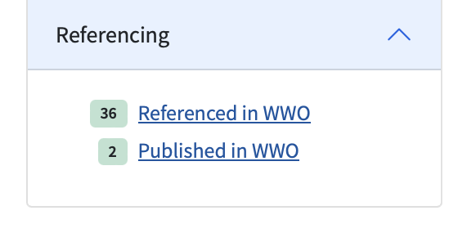

Slide 25
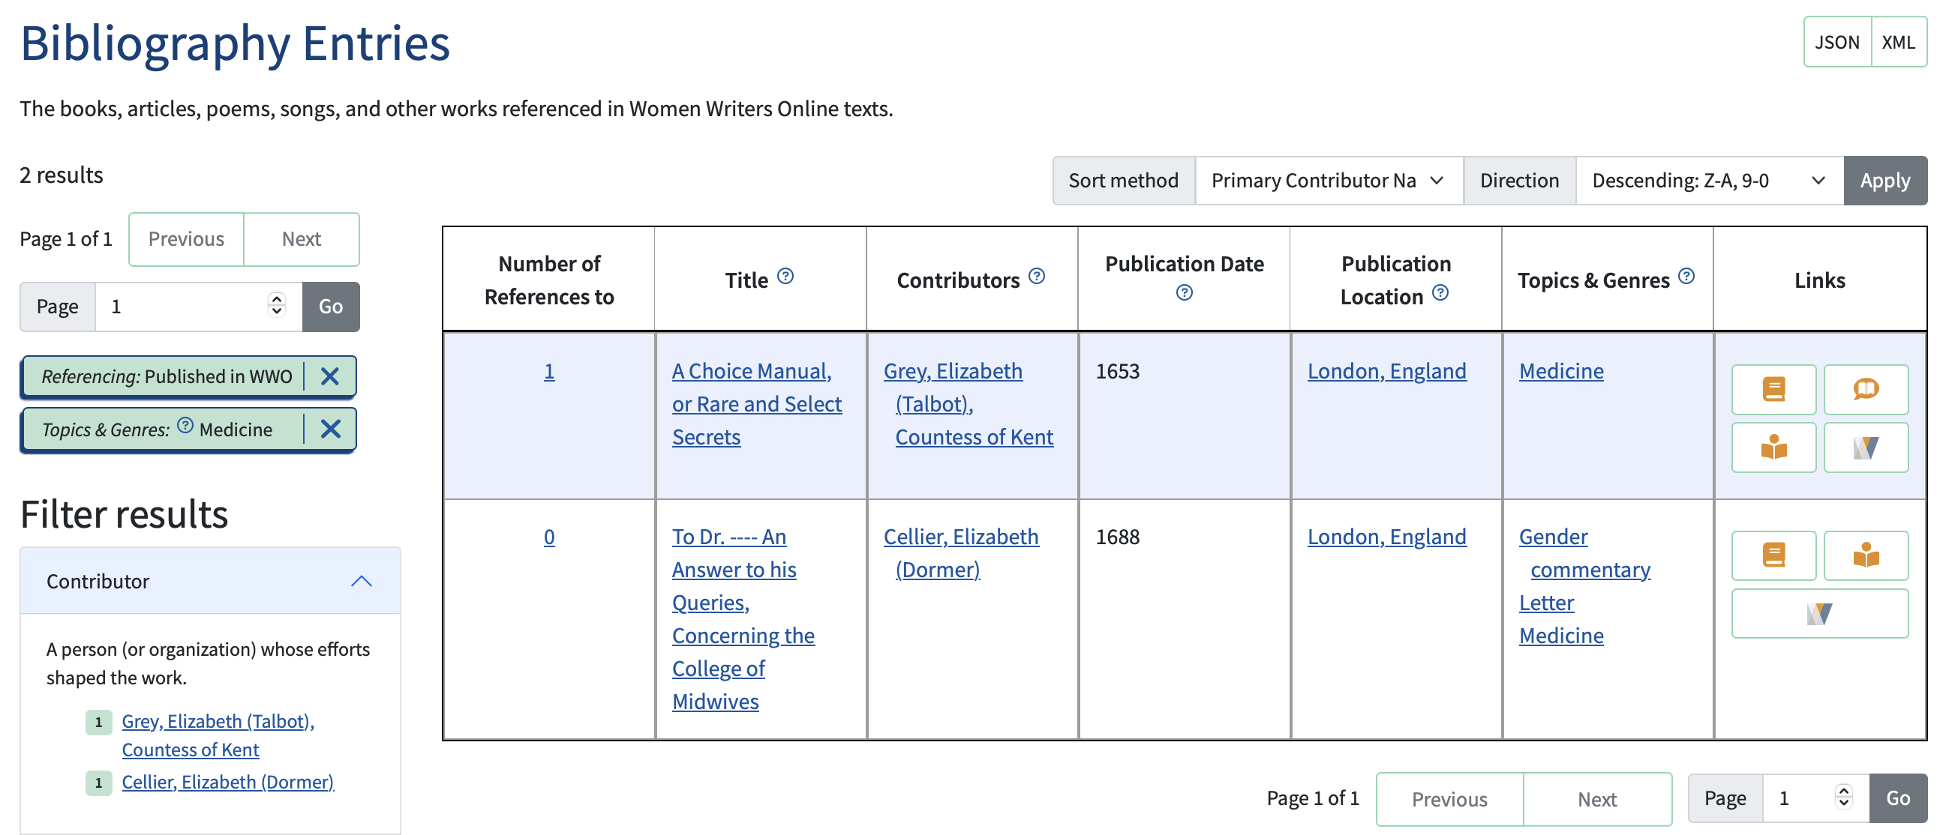
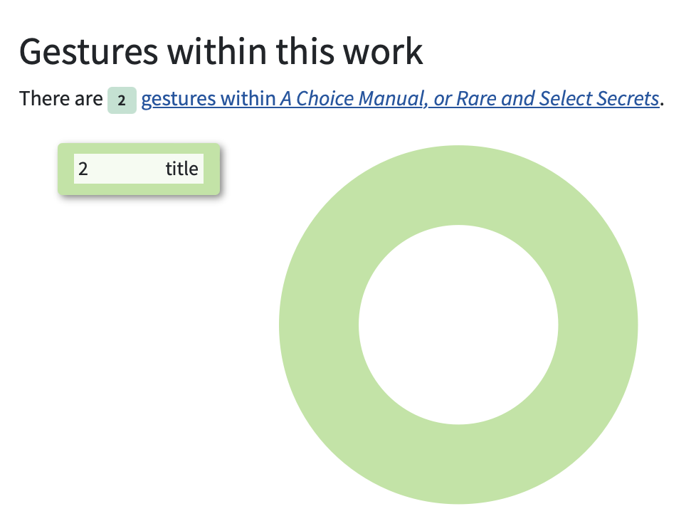
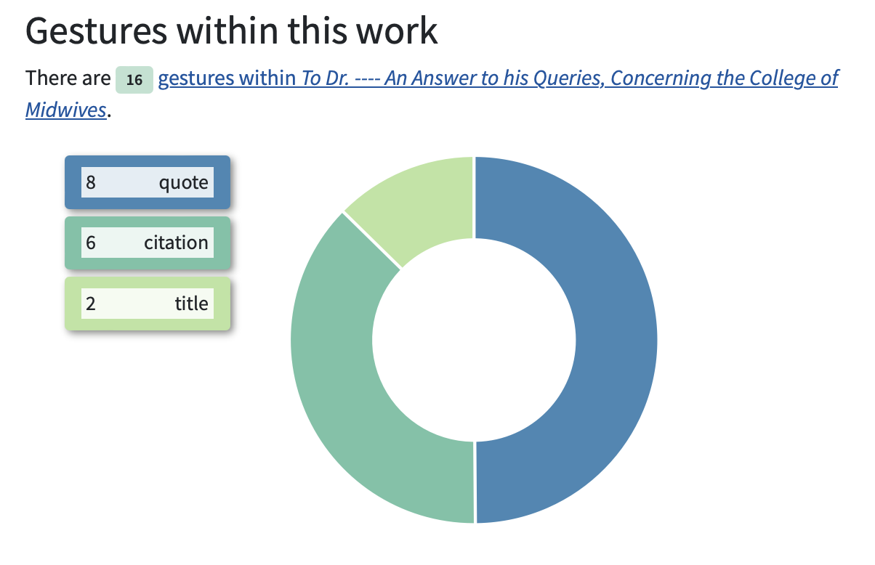

Slide 26
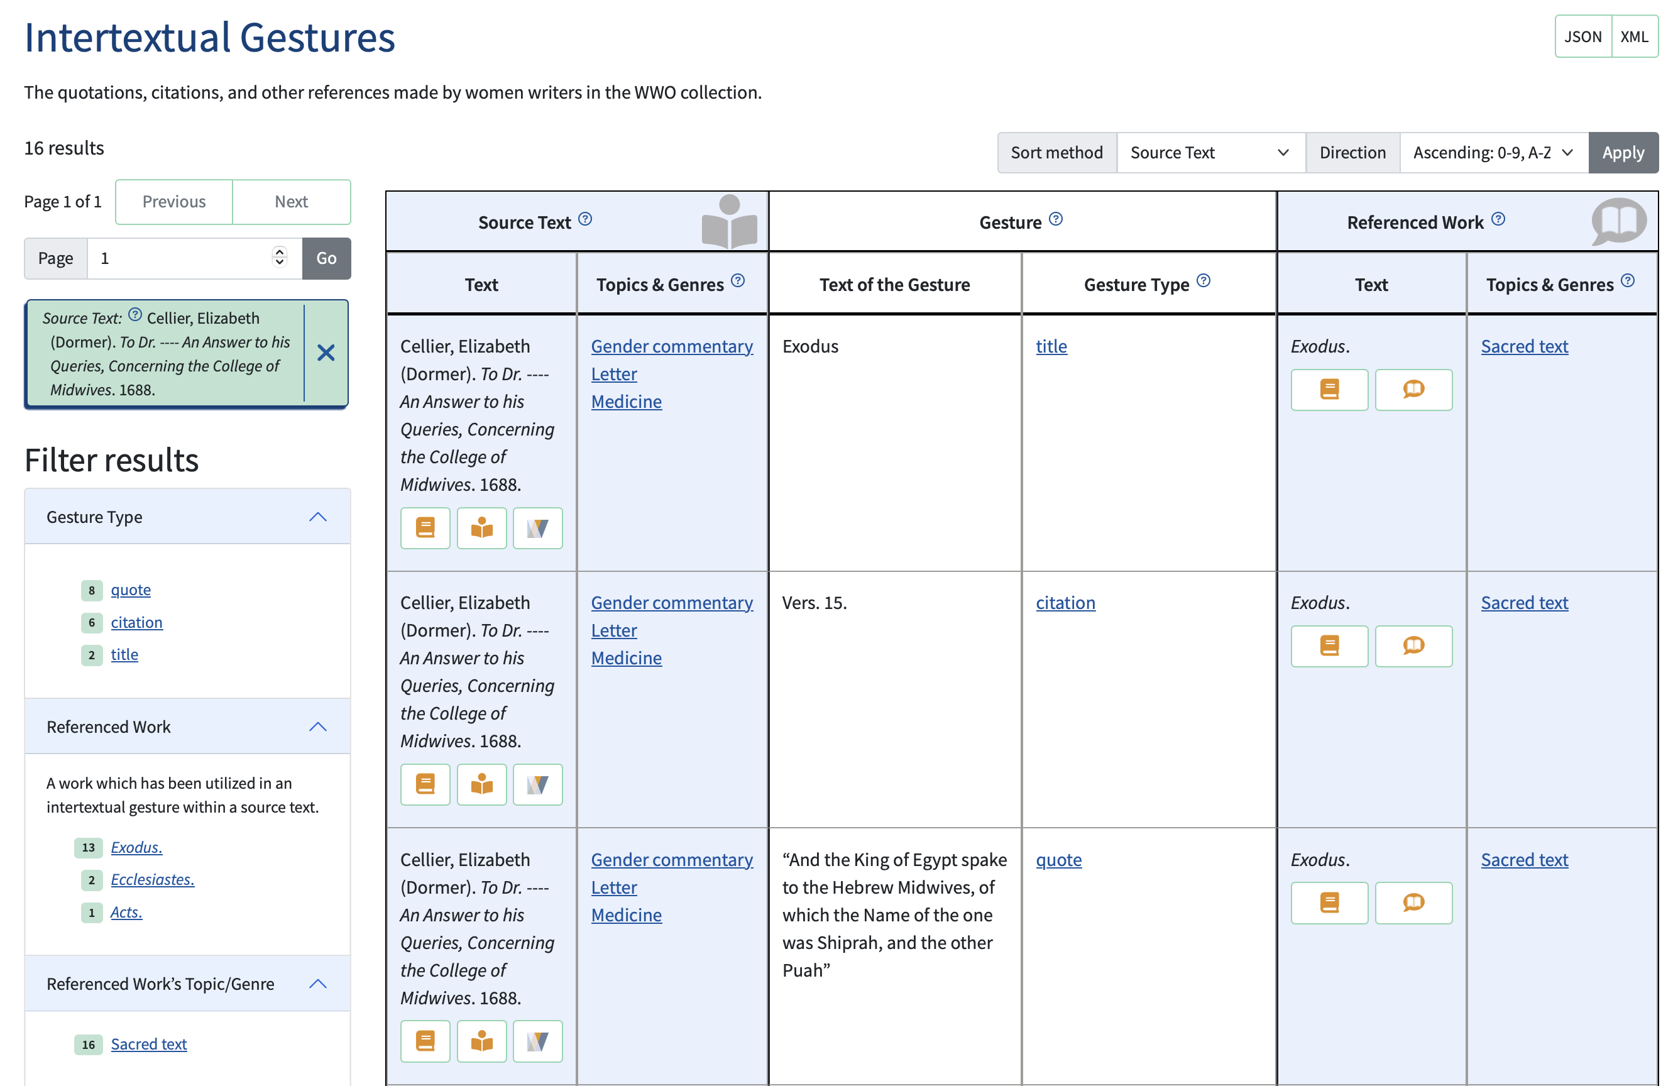

Slide 27
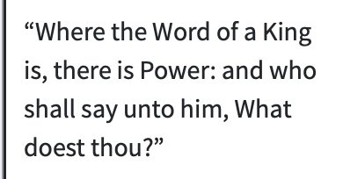
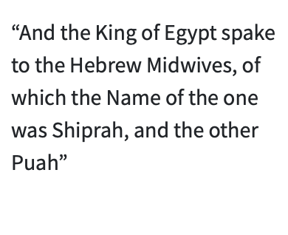
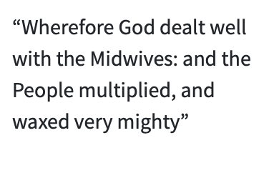
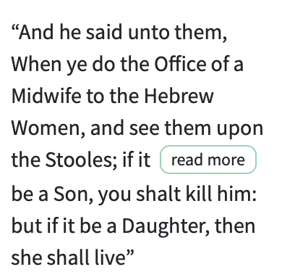
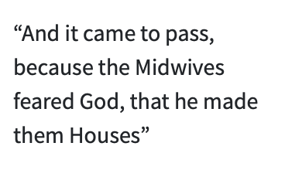
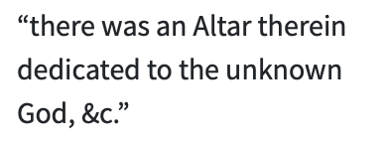
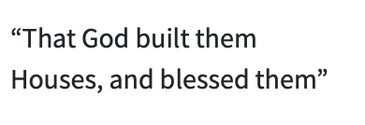
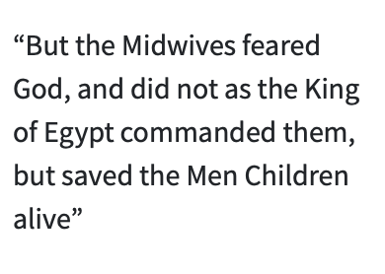

Slide 28
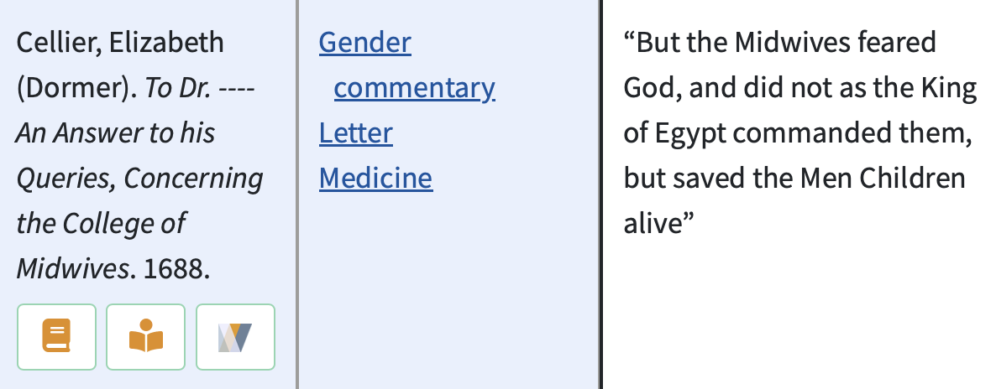
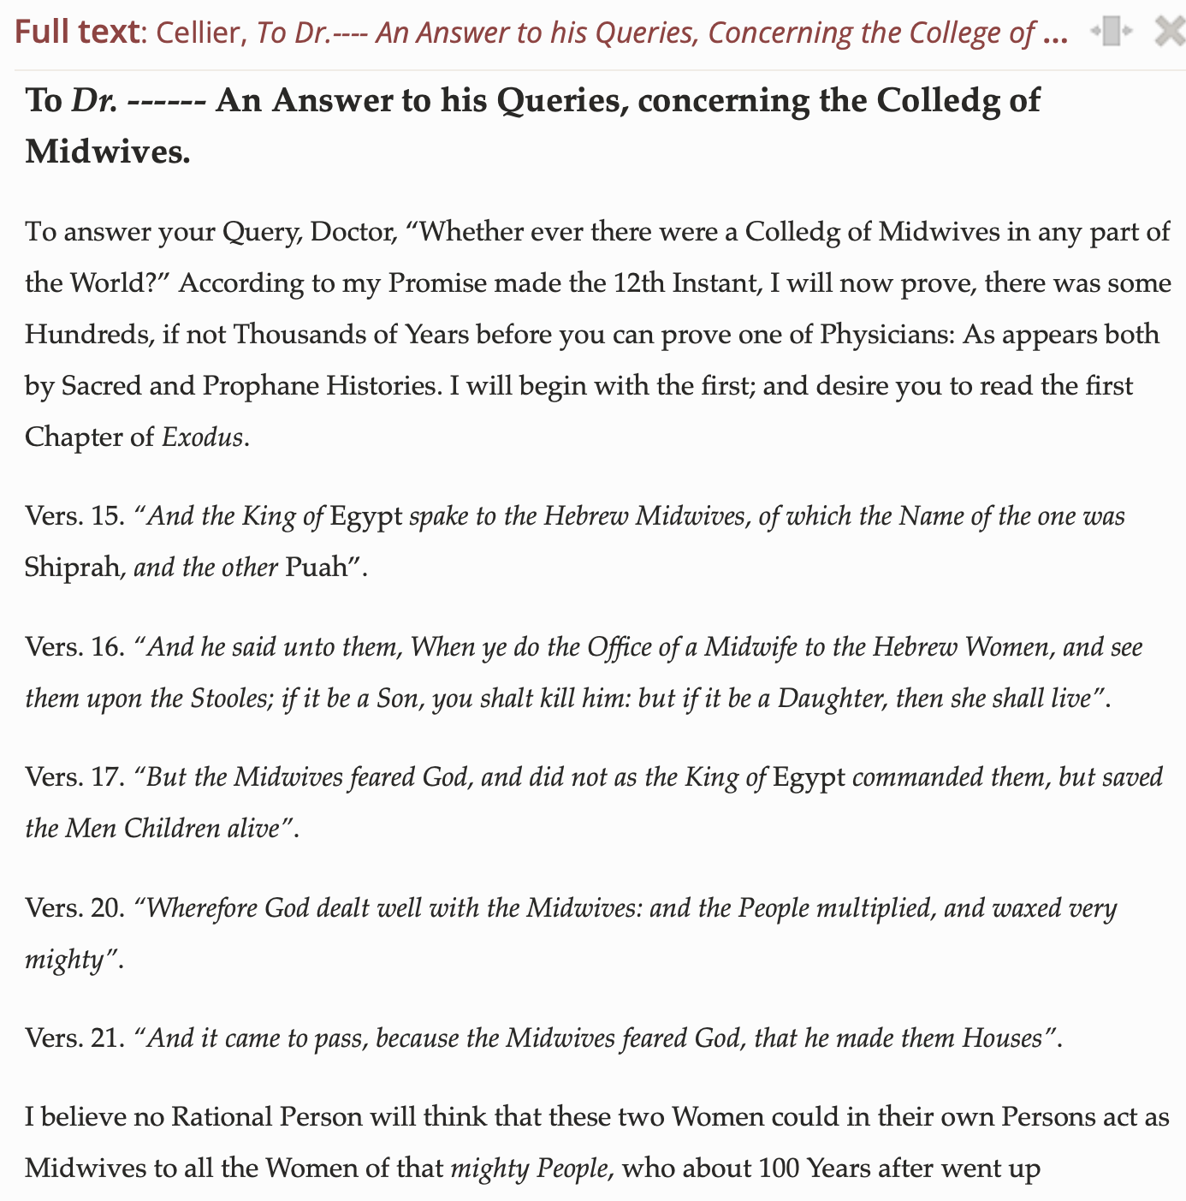

Slide 29
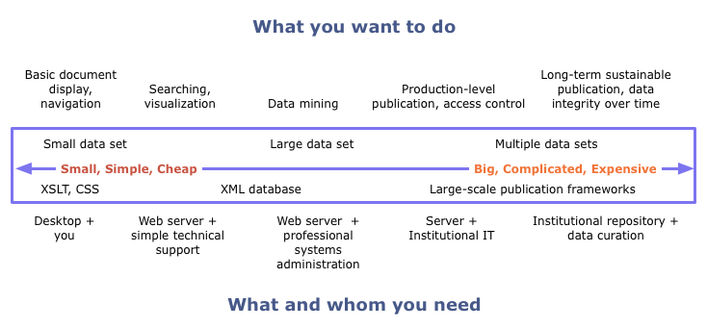

Slide 30
Thank you!

